Slide 1
CG3207 Lab 4 Group 17
Jianning, Vikas, MingShun

Slide 2
Implementation of Datapath Pipelining
5 Stage Pipeline (Fetch, Decode, Execute, Memory, Writeback)
Data Hazard Management in Hardware:
Data Forwarding (M to E, W to E)
Data Forwarding (W to D) to write RegFile at posedge CLK
Data Forwarding (W to M) for Mem-Mem Copy
Load and Use Hazard (Stall F & D, Flush E)
Exceptions to ldrstall when B, LDR, STR, DP Imm as RA2 not used
MCycle Operations (Stall F & D & E, Flush M)
Control Hazard Management in Hardware:
Early BTA with ALUResultE and PCSrcE (Flush D & E)
LDR PC instructions by Flush D & Flush E (effectively flush 4 instructions together with PCSrcE)

Slide 3
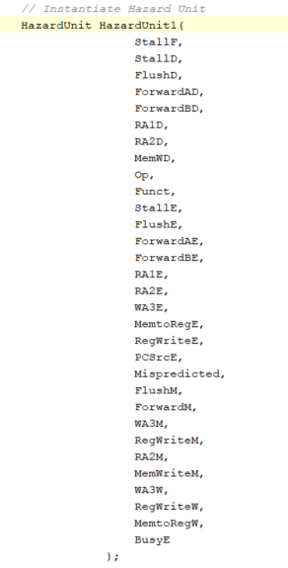
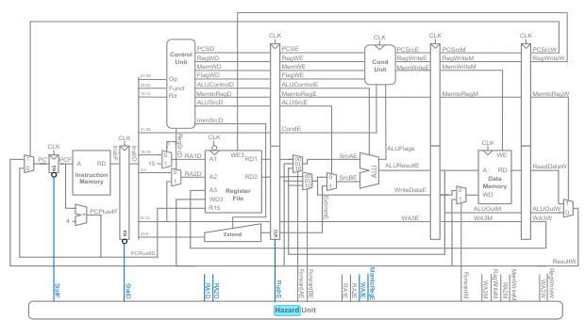
Hazard Unit
*some signals not shown in diagram from lecture slides

Slide 4
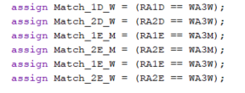
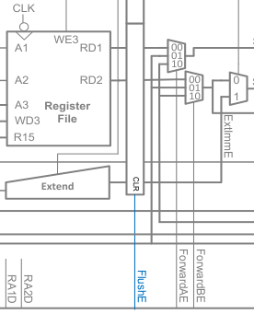

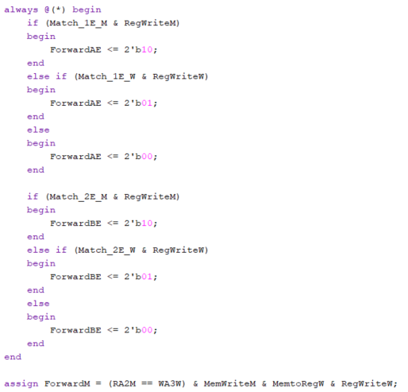
Control Signals for Hazard Management
Data Forwarding

Slide 5
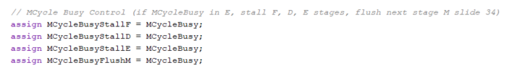
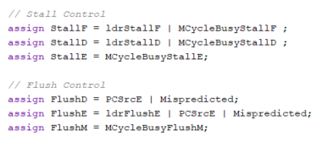
Control Signals for Hazard Management
Load and Use Hazard / Pipeline register Stall and Flush

Slide 6
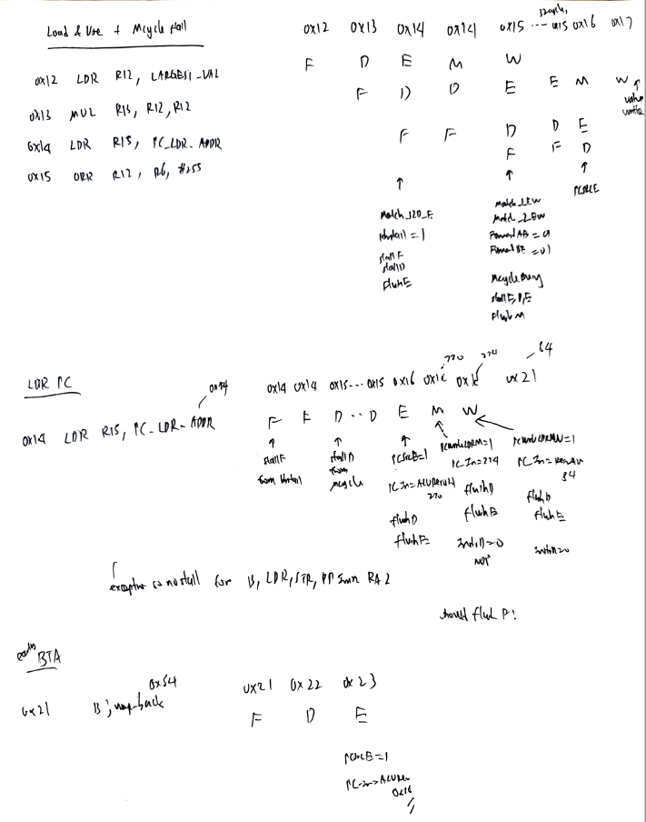
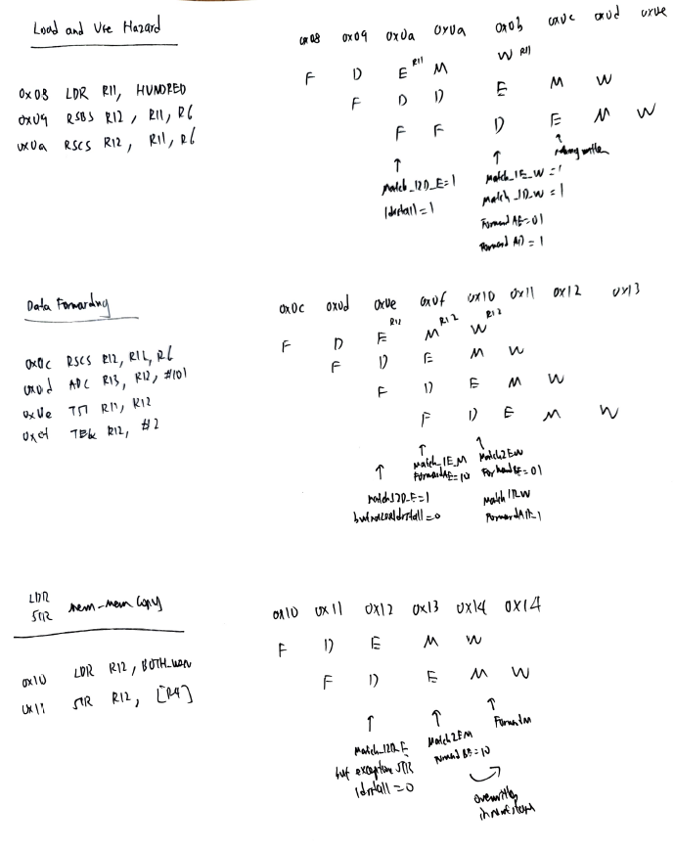
Lab 4 Simulation Trace

